Slide 1
Cards Training – Credit Card
17-May-2018
Venkat Chandran

Slide 2
Purpose of Training
Most people have credit cards — but do everyone know the real players in Payment industry (Cards).
This training will help you understand the deep knowledge of how credit cards work.

Slide 3
BANKING STRUCTURE
RETAIL BANKING
PAYMENTS
CARDS

Slide 4
CARD CREATION LIFE CYCLE

Slide 5
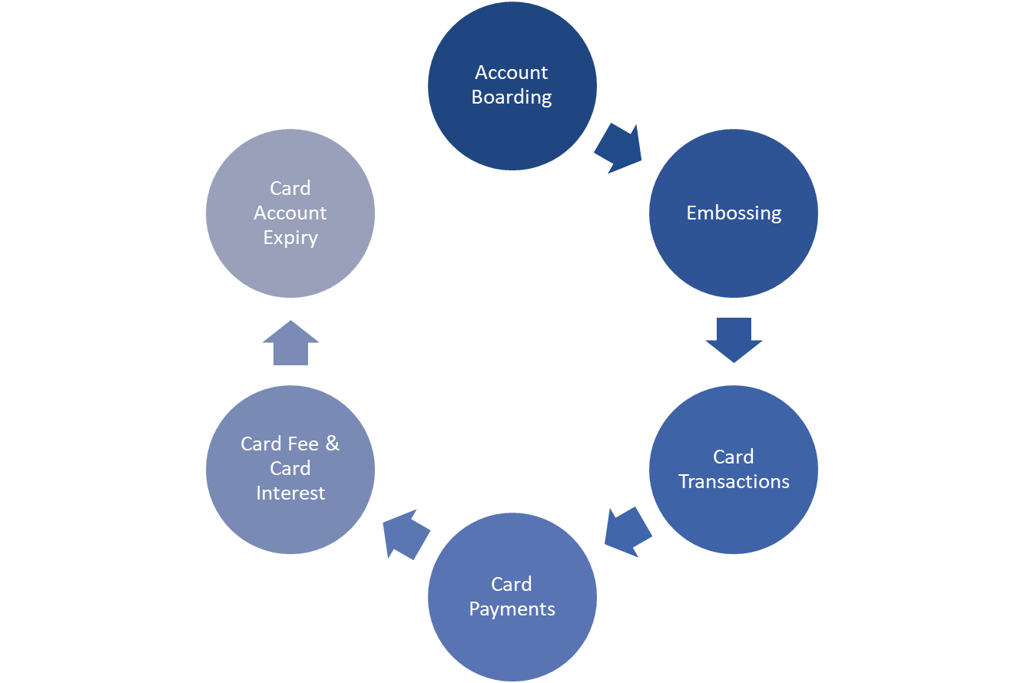
CARDS LIFE CYCLE
OTHER SERVICES
Online Customer Services
Phone banking
SMS services
Letters
Reports
KYC
AML
Customer/Card Account Creation
Card Auto-Reissue
Card Account Closure
  Outstanding Balance Settlement
  Balance Transfer
Embossing Details
Card Features, PIN & CVV
SDP Cards
Card & Pin Mailer
Annual Fee
Overdraft Fee
Interest accrual & posting
Fee & interest Reversal
Merchant / ATM / Online Transaction & Authorization
Cross Country and Border Transaction
Transaction Reversal & Fees
Rewards
FEW KEY PLAYERS
Card Network
Fraud Guard System
API Processing
Payment Due & Payment Due Date
Online / Cheques Payment
Direct Debit / EMI Payment
Transactions & Statements

Slide 6
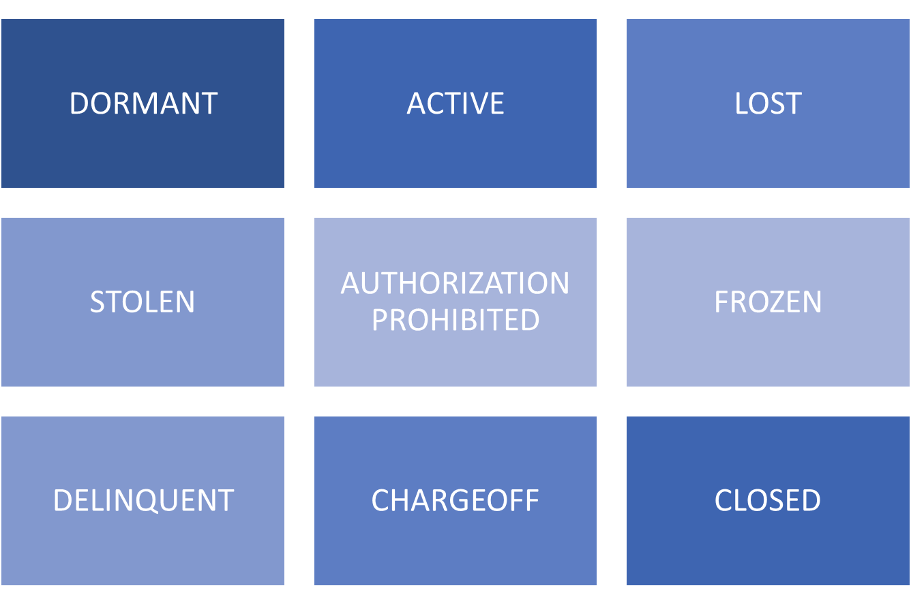
VARIOUS CARD STATUS

Slide 7
CARD PAYMENT LIFECYCLE

Slide 8
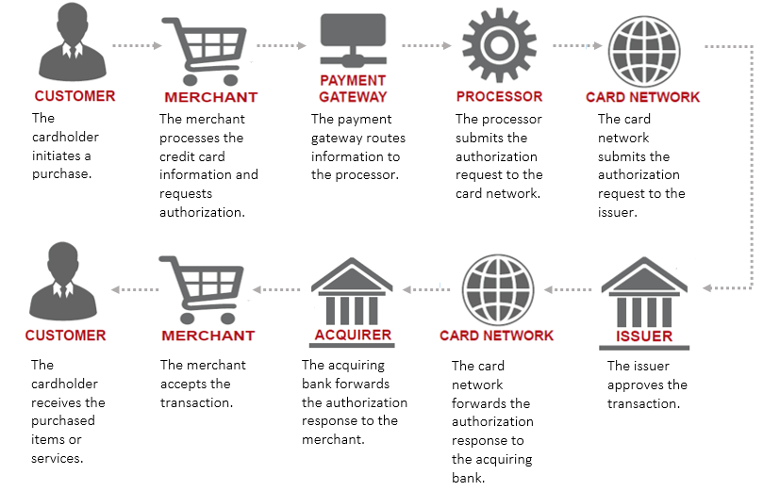

Slide 9





LIST OF PAYMENT GATEWAYS

Slide 10
Credit Card Transaction Participants
Cardholder: While this is pretty self-explanatory, there are two types of cardholders: a “transactor” who repays the credit card balance in full and a “revolver” who repays only a portion of the balance while the rest accrues interest.
Merchant: This is the store or vendor who sells goods or services to the cardholder. The merchant accepts credit card payments. It also sends card information to and requests payment authorization from the cardholder’s issuing bank.
Payment gateway: It is an e-commerce application that authorizes payments for e-businesses, online retailers. It is the virtual equivalent of a physical point of sale terminal located in most retail outlets.
Acquiring Processor/Service Provider: This third-party entity is sometimes an arm of the acquiring bank. A processor provides a service or device that allows merchants to accept credit cards as well as send credit card payment details to the credit card network. It then forwards the payment authorization back to the acquiring bank.
Credit Card Network/Association Member: These entities operate the networks that process credit card payments worldwide and govern interchange fees. Examples of credit card networks are Visa, MasterCard, Discover and American Express. In the transaction process, an credit card network receives the credit card payment details from the acquiring processor. It forwards the payment authorization request to the issuing bank and sends the issuing bank’s response to the acquiring processor.
Issuing Bank/Credit Card Issuer: This is the financial institution that issued the credit card involved in the transaction. It receives the payment authorization request from the credit card network and either approves or declines the transaction.

Slide 11
Card Payment Lifecycle - AUTHORIZATION
Stage 1: Authorization
In the authorization stage, the merchant must obtain approval for payment from the issuing bank.
The cardholder presents their credit card for payment to the merchant at the point of sale.
After swiping their credit card on a point of sale (POS) terminal, the customer’s credit card details are sent to the acquiring bank (or its acquiring processor) via an Internet connection or a phone line.
The acquiring bank or processor forwards the credit card details to the credit card network.
The credit card network clears the payment and requests payment authorization from the issuing bank. The authorization request includes the following:
  Credit card number
  Card expiration date
  Billing address — for Address Verification System (AVS) validation
  Card Security Code — CVC, and Card Verification Value - CVV for instance
  Payment amount

Slide 12
Card Payment Lifecycle - AUTHENTICATION
Stage 2: Authentication
In the authentication stage, the issuing bank verifies the validity of the customer’s credit card using fraud protection tools such as the Address Verification System (AVS) and card security codes such as CVV, CVV2, CVC2 and CID.
The issuing bank receives the payment authorization request from the credit card network.
The issuing bank validates the credit card number, checks the amount of available funds, matches the billing address to the one on file and validates the CVV number.
The issuing bank approves, or declines, the transaction and sends back the appropriate response to the merchant through the same channels: credit card network and acquiring bank or processor.
Once the merchant receives the authorization, the issuing bank will place a hold in the amount of the purchase on the cardholder’s account. The merchant’s POS terminal will collect all approved authorizations to be processed in a “batch” at the end of the business day.
The merchant provides the customer a receipt to complete the sale.

Slide 13
Card Payment Lifecycle - CLEARING & SETTLEMENT
Stage 3: Clearing & Settlement
In the clearing stage, the transaction is posted to both the cardholder’s monthly credit card billing statement and the merchant’s statement. It occurs simultaneously with the settlement stage.
At the end of each business day, the merchant sends the approved authorizations in a batch to the acquiring bank or processor.
The acquiring processor routes the batched information to the credit card network for settlement.
The credit card network forwards each approved transaction to the appropriate issuing bank.
Usually within 24 to 48 hours of the transaction, the issuing bank will transfer the funds less an “interchange fee,” which it shares with the credit card network.
The credit card network pays the acquiring bank and the acquiring processor their respective percentages from the remaining funds.
The acquiring bank credits the merchant’s account for cardholder purchases, less a “merchant discount rate.”
The issuing bank posts the transaction information to the cardholder’s account. The cardholder receives the statement and pays the bill.

Slide 14
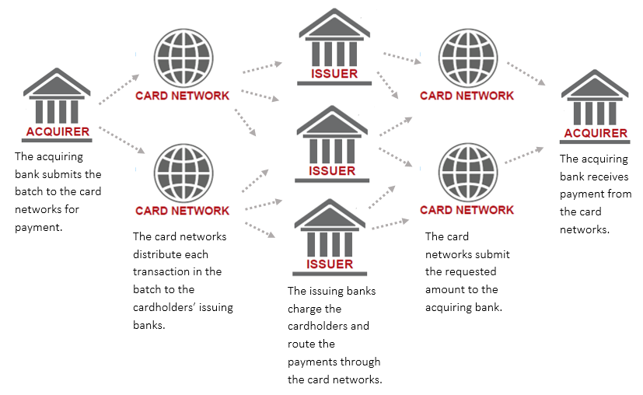
CLEARING PROCESS

Slide 15
PROCESSING PAYMENT CARD TRANSACTIONS
Interchange procedures apply to five stages: first presentment, first chargeback, second presentment, arbitration chargeback, and arbitration case filing.
First Presentment: Merchants submit a batch of transactions to the acquirer for processing. The acquirer facilitates the clearing of a transaction by communicating information through MasterCard to the issuer. This initiates the settlement process which moves the net value of the transaction to the merchant’s account from the cardholder’s account. This interchange procedure is known as first presentment.
First Chargeback: After processing the initial transaction, the issuer may later determine the first presentment is invalid. The issuer can return the transaction to the acquirer with a first chargeback. The issuer can initiate the chargeback or act in accordance with a cardholder’s request.
Second Presentment: If the acquirer has sufficient evidence to dispute the chargeback and prove the validity of the first presentment, interchange procedures allow for a second presentment. If the second presentment is found in the merchant’s favor, funds will be returned to the merchant’s account.
Second/Arbitration Chargeback: If the Issuer is still not satisfied with Second Presentment, then it presents Acquirer with Arbitration chargeback.
If the dispute/claim is still not resolved, then the card Network will come out of the dialogue and only Acquirer and Issuer will solve the issue directly.

Slide 16
PRESENTMENT & CHARGEBACK
Presentment:
The networks define presentment as the act of submitting a transaction for clearing. Therefore, if a merchant waits too long to present a transaction, the merchant runs the risk of experiencing a late presentment chargeback.
In short we say : Presentment is a clearing record that an acquirer presents to an issuer through interchange, either initially (a first presentment) or after a chargeback (a re-presentment).
Chargeback:
A chargeback is a transaction reversal meant to serve as a form of consumer protection from fraudulent activity committed by both merchants and individuals.
Merchant/
Acquirer
FP
Card Network
MasterCard/Visa
FP
Issuer
FCB
FCB
SP
SP
SCB/ACB
SCB/ACB

Slide 17
Types of Chargebacks
Chargebacks can be categorized into three types.
1. Merchant Error
Following are some of the observed reasons of these chargebacks-
System errors or problems arising from your business process
Poor customer service
Unwanted recurring payments
Authorization errors or faulty product fulfillment.
2. Unauthorized Card Use
This category deals with an actual fraud. Purchase made by an individual is completed by a presumably stolen credit card information while the legitimate card holder is unaware of the transaction made. So, the owner of the credit card is sure to file a chargeback. Such a transaction is illegal and laws in place can severely punish the person held responsible for this crime.
3. Friendly Fraud
This type of fraud is also considered to be an honest and innocent mistake. But this time, unlike from merchant’s side in ‘Merchant Error’ category, this is a mistake from consumer’s side.

Slide 18
CREDIT CARD PAYMENT TRANSACTION FEES
For the convenience of their customers, many merchants accept credit cards as payment. But you may have wondered why some merchants will accept only cash or require a minimum purchase amount before allowing the use of a credit card. Here’s why: Merchants must pay a price to accept credit card payments. Hence, most will seek the cheapest credit card processing rates or mark up the prices of their products so customers’ payments can absorb the card-processing cost.
Depending on the type of merchant and through which platform a good or service is delivered (e.g., at the retail store, through e-commerce or by phone), credit card processing rates will vary. They usually are charged as flat fees, per-transaction fees or volume-based fees. For the purpose of this guide, only major costs will be explained below:
Merchant Discount Rate: Merchants pay this fee for accepting credit card payments and receiving service from acquiring processors. It’s usually between 2% and 3% (online merchants pay the higher end) — to as much as 5% — of the total purchase price after sales tax is added. Also known as a discount fee, this rate comprises several components:
Interchange Fee: The acquiring bank and acquiring processor pay this fee to the issuing bank. It is market-based and set by each credit card network (except American Express). Visa and MasterCard, for instance, update their interchange rates twice per year. Most interchange fees are assessed in two parts: a percentage to the issuing bank and a fixed transaction fee to the credit card network. For instance, the per-swipe fee might be 2.35% plus $0.15.
  Interchange fees vary and are categorized through a process called “interchange qualification,” which determines the rate based on several criteria:
    Physical presence or absence of the card during the transaction
    Processing method used (e.g., swiped, manually entered or e-commerce)
    Credit card company

Slide 19
CREDIT CARD PAYMENT TRANSACTION FEES
    Card type (e.g., regular, premium, commercial, rewards or government-issued)
    Merchant’s business type (as determined by merchant category code)
Assessments: Credit card networks (except American Express) charge this fee for transactions that are made with their branded cards. It usually is based on a percentage of the total transaction volume for the month. The fee usually is fixed, and the merchant’s acquiring bank may not charge a lower rate or negotiate a better deal with the merchant. Assessments generally are charged per transaction but can vary depending on the pricing model the merchant follows. For instance, Visa might charge a 0.11% assessment plus $0.0195 processing or usage fee for each card swipe. Assessment amounts may change periodically. Combined with the interchange fee, assessments constitute between 75% and 80% of total card-processing costs.
Markups: Acquiring banks and acquiring processors usually will include a markup over interchange fees and assessments partly as profit and partly to cover the cost of facilitating credit card transactions. It constitutes between 20% and 25% of total card-processing costs. Merchants generally can negotiate the markup with the entities that charge them.
Chargebacks: Customers reserve the right to dispute a charge on their credit card billing statement within 60 days of the statement date. When the issuing bank receives a complaint from a customer, it charges the merchant between $10 and $50 as a penalty and for issuing a “retrieval request.” If the merchant doesn’t respond to the retrieval request within a certain timeframe, it could incur additional fees. The merchant may appeal, but the process is long and likely to favour the customer. If the merchant loses, the issuing bank will recover, or charge back, the customer’s payment.

Slide 20
PIN Security and Key Management
Organizations handling debit and ATM personal identification numbers (PINs) are responsible for safeguarding this sensitive information. This responsibility not only makes sense from a customer service perspective amidst rising identity theft cases, but keeping PINs secure is required to comply with the American National Standards Institute (ANSI) rules on PIN security and for membership in major payment networks like MASTERCARD, VISA, AMEX etc.
Payment networks require their members to complete and submit the Technical Report 39 (TR-39) every other year to maintain good member standing. TR-39 has been viewed as the industry standard in PIN security and key management.
Encryption:
Encryption is the process of using an algorithm to transform information to make it unreadable for unauthorized users.
This cryptographic method protects sensitive data such as credit card numbers by encoding and transforming information into unreadable cipher text.
This encoded data may only be decrypted or made readable with a key. Symmetric-key and asymmetric-key are the two primary types of encryption.
Decryption:
Decryption is the process of transforming data that has been rendered unreadable through encryption back to its unencrypted form.
In decryption, the system extracts and converts the garbled data and transforms it to texts and images that are easily understandable not only by the reader but also by the system.
Decryption may be accomplished manually or automatically. It may also be performed with a set of keys or passwords.

Slide 21
PIN Security and Key Management
A hardware security module, or HSM, is a dedicated, standards-compliant cryptographic appliance designed to protect sensitive data in transit, in use, and at rest through the use of physical security measures, logical security controls, and strong encryption.
An HSM’s core functionality is centred around encryption: the process by which sensitive data is rendered indecipherable to all except authorized recipients. HSMs also offer a secure way to decrypt data to ensure message confidentiality and authenticity.
Encryption is made possible through the use of encryption keys—randomly generated values that must be kept secret in order to protect the encrypted data. Because knowledge of the encryption key aids in decrypting information, it is vital that these keys are secured in a private environment.
Hardware security modules generate and store the keys used for encrypted communication among devices within a Secure Cryptographic Device (SCD), which is a far more secure method than solely using software. When information is sent to the HSM via a trusted connection, the HSM allows for the quick and safe encryption or decryption of that information using the appropriate key.

Slide 22
3-D Secure Image
3D Secure (3-domain secure), also known as Payer Authentication is a security protocol to prevent fraud in transactions with credit and debit cards online It allows shoppers to create and assign a password to their card that is then verified whenever a transaction is processed through a site that supports the use of the scheme. The addition of password protection allows extra security on transactions that are processed online.
3D Secure stands for 3 Domain Server, there are 3 parties that are involved in the 3D Secure process :
The company the purchase is being made from.
The Acquiring Bank (the bank of the company)
VISA and MasterCard (the card issuers themselves)
The scheme is a collective of Verified by VISA (VBV) and MasterCard Secure Code (MSC). It is the most recent fraud prevention initiative that is available at the moment.
3D Secure is also the only fraud prevention scheme that is available that offers companies liability cover for transactions that are verified by the checks. This provides additional protection to companies using the scheme as opposed to those that do not.

Slide 23
3-D Secure Image
What are the benefits of using 3D Secure?
Liability Shift :
No extra cost :
Easy to set up and control :
Are there any limitations of using this?
Chargeback's can still occur : As regards to chargeback liability, 3D Secure should be seen as an additional layer of protection provided by the card issuer. In fact, in the case of a fraudulent transaction, it becomes authenticated through 3D Secure, is very likely that liability will shift to the acquirer. In short, retailers are protected against misleading chargeback's since the liability is transferred.
Not all cards are part of the scheme : At the moment there are no similar initiatives for JCB or Diner’s club cards.

Slide 24
COLLECTIONS
Skipped payments in a row leads to Card delinquency which in turn results in collections.
In most cases, a missed payment and a delinquency is likely to stay on your credit report for about seven years.
Once you are more than 60 days late on your credit card payment, creditors will report your delinquency to one or all of the major national credit bureaus.
Eventually, after enough missed payments, your account may be placed with a collection agency or, eventually, charged off.
You may start to receive calls or notices from the collection agency asking you to pay.

Slide 25
REWARDS
Below are the common card deals offered by banks for Purchase of products and services:
    Cashback
    Discount
    Additional Reward Points
    Gift Coupons
    Balance Transfer
    Periodic offers – Weekly a day
    Charge / Fees Waiver
    Easy Payment Plan

Slide 26
FRAUD MANAGEMENT SYSTEM
The use of credit cards is prevalent in modern day society. But it is obvious that the number of credit card fraud cases is constantly increasing in spite of the chip cards worldwide integration and existing protection systems. This is why the problem of fraud detection is very important now.
Card fraud begins either with the theft of the physical card or with the compromise of data associated with the account, including the card account number or other information that would routinely and necessarily be available to a merchant during a legitimate transaction.
Stolen cards can be reported quickly by cardholders, but a compromised account can be hoarded by a thief for weeks or months before any fraudulent use, making it difficult to identify the source of the compromise. The cardholder may not discover fraudulent use until receiving a billing statement, which may be delivered infrequently.
  For this purpose various fraud prevention techniques which have been used in the developed countries have been studied. A new model is proposed which tries to overcome the weaknesses of this system Online Credit Card Fraud Prevention
  Customer registers with customer’s bank
  Customers enters credit card details (credit card number, security code, expiry date)
  Customers information is encrypted and sent to merchant
  Merchant Decrypts the data
  Merchant encrypts the data and sends it to acquirer bank
  Acquirer bank decrypts the data & verifies the data from issuer bank

Slide 27
FRAUD MANAGEMENT SYSTEM
  Issuer bank executes the “checks”
  Issuer bank sends the result to acquirer bank
  Acquirer bank sends message to merchant
  Merchant sends a success message to customer if all checks are true
  Merchant sends a failure message to customer if any check is not true
  Merchant sends an email notification to the customer.
Proposes Fraud Prevention Technique for online transactions
  Lost / Stolen
  Credit Card Validation
  Security Code Check
  Expiry
  Multiple IP
  Repeated IP
  Proposes Fraud Prevention Technique for manual transactions
  Spending modal verified
  Location identifier
  ID Proof validation

Slide 28
VIRTUAL CREDIT CARDS
A virtual credit card number is a randomly-generated card number associated with your actual credit card.
Depending on the issuer, you may be able to set a maximum charge for the virtual number, further protecting your transaction. And typically you can set it to expire in anywhere up to a year from its creation date.
To the online merchant, it looks no different from any other credit card.
The charges appear on your regular bill, but the merchant doesn't have your actual credit card number.
Customers can usually perform only one transaction using one virtual card where they are able to use all the credited balance or a portion of it.
If there is any balance amount remaining on the virtual credit card, the amount is credited back to the original account of the customer.
Virtual credit cards are issued only to the primary card holder, not to any secondary card holders.

Slide 29
Types of Cards

Slide 30
Payment Card Types
Types of payment cards can be distinguished on the basis of the features of each type of card, including:
    Credit card
    Charge card
    Debit card
    Prepaid card
    Islamic card
    Corporate card

Slide 31
Payment Card Types
CREDIT CARD
  Revolving Credit
    Credit line can be used up to the credit limit
    Pay charges in full each month, pay just the minimum, or make a partial payment greater than the minimum due
    Available credit goes up and down as purchases and payments are made
    CHARGE CARDS
  Pay all charges in full every month by the due date
    Cannot carry a balance
    No balance = no interest
    Some charge cards allow a balance carry-over for specific purchases, such as travel charges
    DEBIT CARDS
  It is similar to a credit card, but unlike a credit card, the money comes directly from the user's bank account while performing a transaction.

Slide 32
Payment Card Types
PREPAID CARDS
  Also called stored value cards
  These are used by
    retailers as gift cards
    travelers as a safe way to get funds on the road
    parents who want to give their kids the convenience of a credit card without the risk
    ISLAMIC CARDS
  An Islamic credit card offers a viable option for Muslims to have the convenience of a credit card while keeping true to their faith.
  It’s also an alternative option for non-Muslims as you don’t necessarily have to be Muslim to have an Islamic credit card.
  For non-Muslims who prefer the concept of Islamic banking, an Islamic credit card would give them an option aside from the conventional credit card.
  Interest (RIBA) is not charged on Islamic Cards
  QIBLA cards are Islamic cards that have compass embossed on them in order to show the direction of MECCA

Slide 33
Payment Card Types
CORPORATE CARDS
  Corporate credit cards are a distinct group within the greater credit card universe, separate from both personal and even the best small business credit cards.
  Companies may provide their employees with corporate cards for the payment of approved, business-related expenses, most often travel-related.
  Usually issued in the company's name, corporate cards also display the name of the individual employee cardholder.
  Unlike personal and small business cards, corporate credit cards are offered by only a few issuers.
  Corporate credit card accounts are generally established by businesses using a banking relationship or via a deal negotiated directly with a card issuer.
  In developing such a relationship, the company's credit is considered, just as an individual's credit is considered when applying for a consumer credit card.

Slide 34
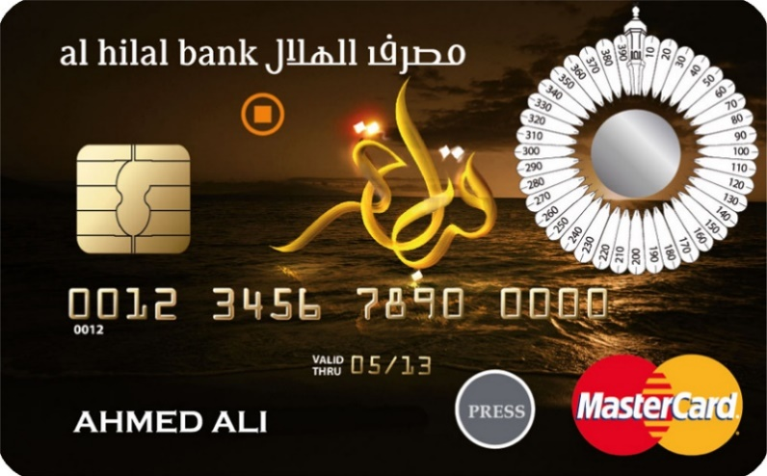
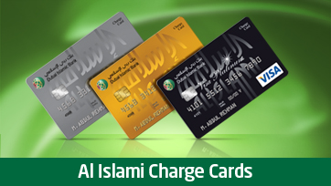
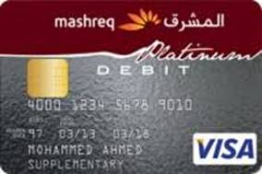
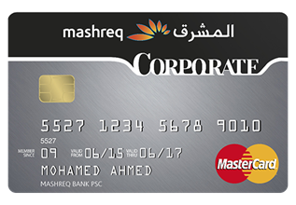
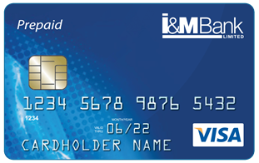
Islamic Card Charge Card
        Debit Card
Corporate Card Prepaid Card

Slide 35
CREDIT CARD FEES

Slide 36
Credit Card Fees
ANNUAL FEES
  Annual fees are common on charge cards, “rewards” and airline miles credit cards
  Sometimes an annual fee will be applied if you do not make at least a few charges during the year
  BALANCE TRANSFER FEES
  Charge for transferring a balance from another credit card
  Commonly assessed as a percentage of the transferred amount (for example, 3%)
  CASH ADVANCE FEE
  Commonly charged as a percentage of the cash advance (for example, 3%)
  Minimum charges are common
  A maximum charge may limit the amount paid, but these are not as common as minimum charges
CURRENCY CONVERSION FEES
  Fees charged for purchases made overseas, or purchases made from companies based outside the U.S.
  Also called a foreign exchange fee or surcharge
  Fees vary by issuer

Slide 37
Credit Card Fees
  LATE FEES
  Charged if your payment is late
  Payments received on the due date before 5 p.m. cannot be considered late
  Your due date must fall on the same day each month
OVER DRAFT FEES
  Charged if you go over your credit limit AND you have given permission to the card issuer to charge a fee if you exceed your credit limit
  Only one over-limit fee allowed per billing cycle
  If you don’t give permission, you don’t get fee AND transactions that would push you over limit are likely to be declined

Slide 38
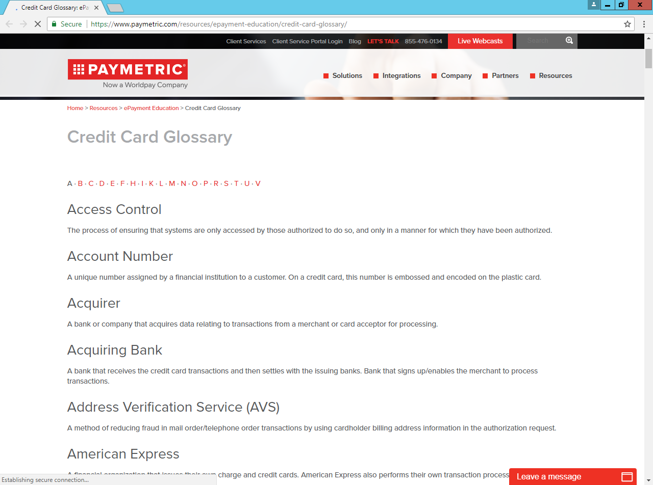
GLOSSARY
Important card terminologies can be found in the below Link:
https://www.paymetric.com/resources/epayment-education/credit-card-glossary/

Slide 39
To maintain a Wise credit:
Not managing your credit wisely can lead to:
  Increased annual percentage rates (APRs)
  Unnecessary fees
  A decline in your credit
  Denials of future credit

Slide 40
?

